Slide 1

Digitalization of Business Processes in Health
Case: Digital Pharmacy
Team: Nemanja Arsenijevic, Ruben Ballesteros, Houssem Bouchemal, Kurt Kuser, Blanca Moreno

Slide 2
Table of contents
1
2
3
4
5
Use Case
As-Is Process
Solution
To-be Process
Implementation
Benefits
6
Demonstration
7

Slide 3
Use Case: The Pharmacy Experience
Pain Points:
Long waiting times
Limited opening times
Stock-outs discovered at counter
Low privacy as busy counters
Manual tasks: repeated data entry or callbacks
Service
Rx
OTC
Notes:
Long waits during peak hours
Limited opening times could lead to rush consultations near closing
Repeated manual data entry for staff
Stock-outs might only be discovered at the counter (requiring extra trips for customer)
Low privacy at busy counters (when patient has sensitive questions)
Manual tasks (data entry, callbacks, paper logs)

Slide 4
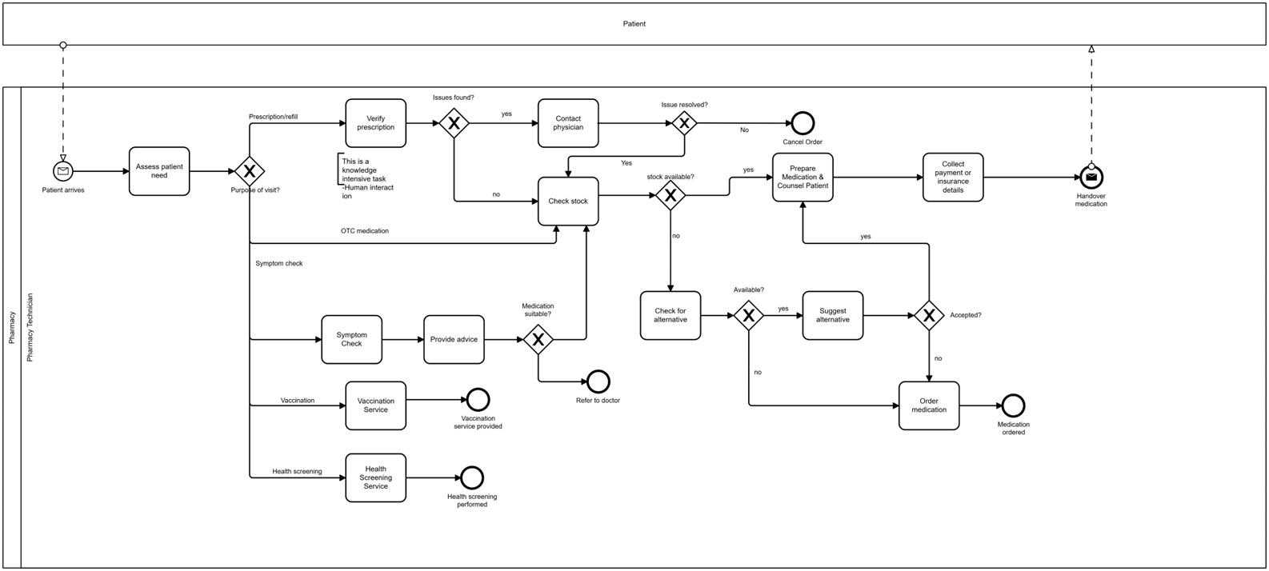
As-Is Process

Slide 5


Solution
ChatBot
Digitalize customer experience
Symptom Triage
Rx upload
OTC ordering
Automation
Inventory reoder
Inventory update
Patient notifications

Slide 6
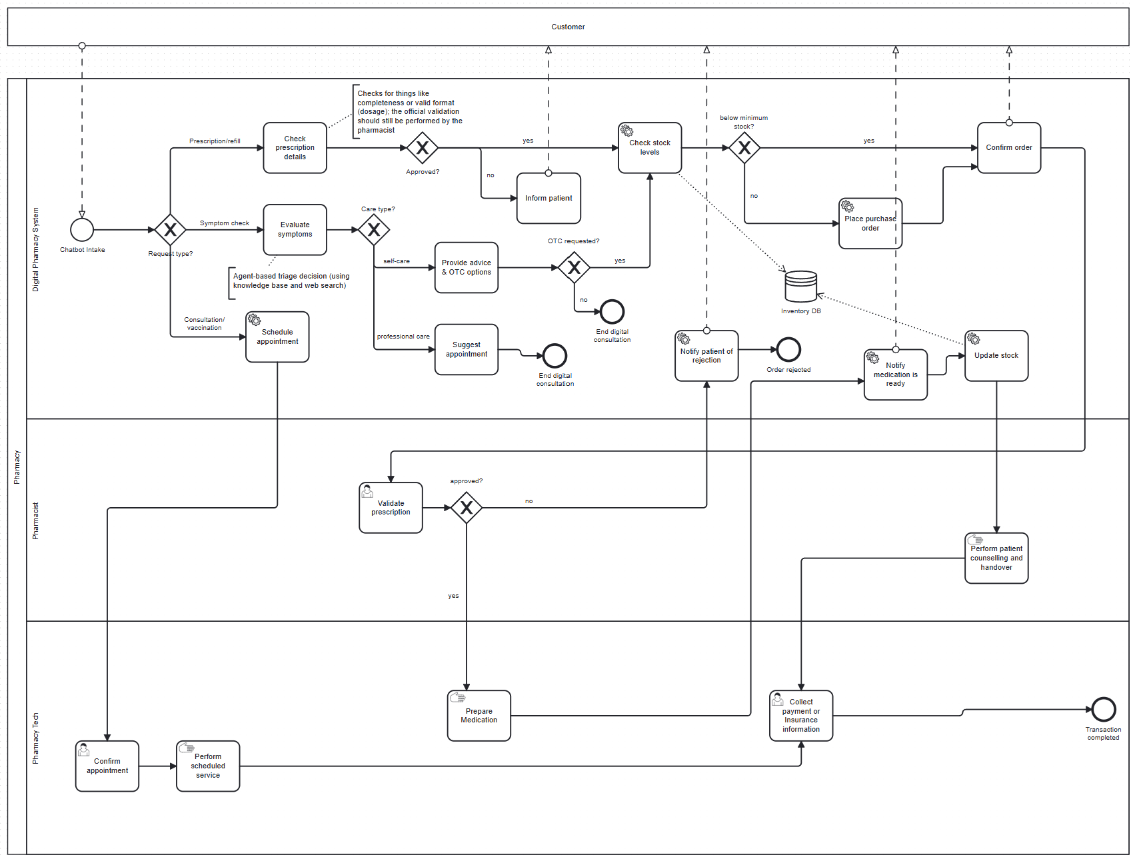
To-Be Process (Documentation/Visualization)

Slide 7
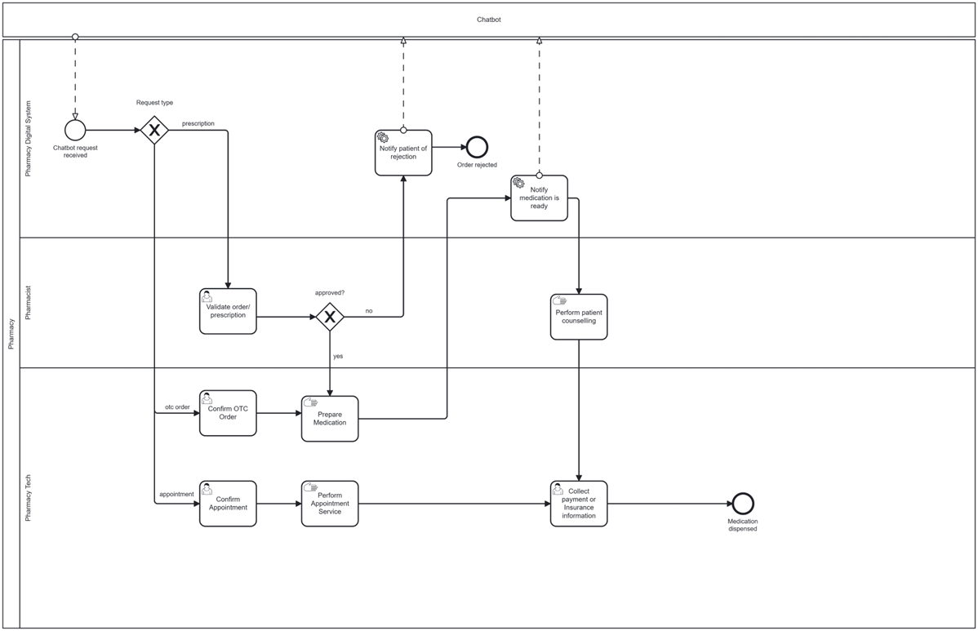
To-Be Process (Executable)

Slide 8
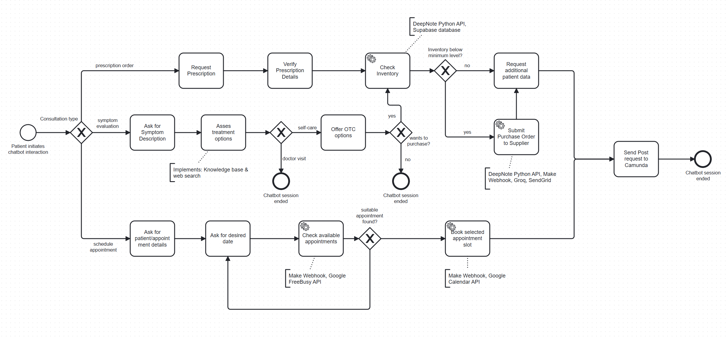
Chatbot

Slide 9





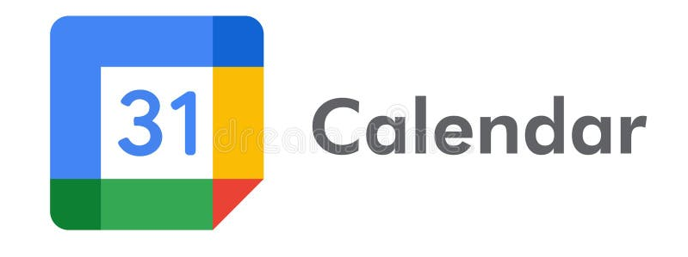
Implementation Tools
Inventory
PO Submission
Groq
SendGrid
Customer Notifications
Order Flow
Appointment
Inventory
FreeBusy & Events API

Slide 10
Benefits
24/7 customer intake
Reduced wait times
Streamlined processes
Task automation
Reduction of manual tasks

Slide 11
Demo

Slide 12
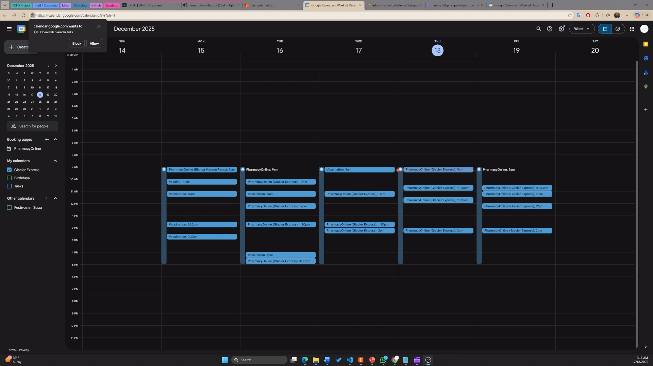
Appointment Scheduling

Slide 13
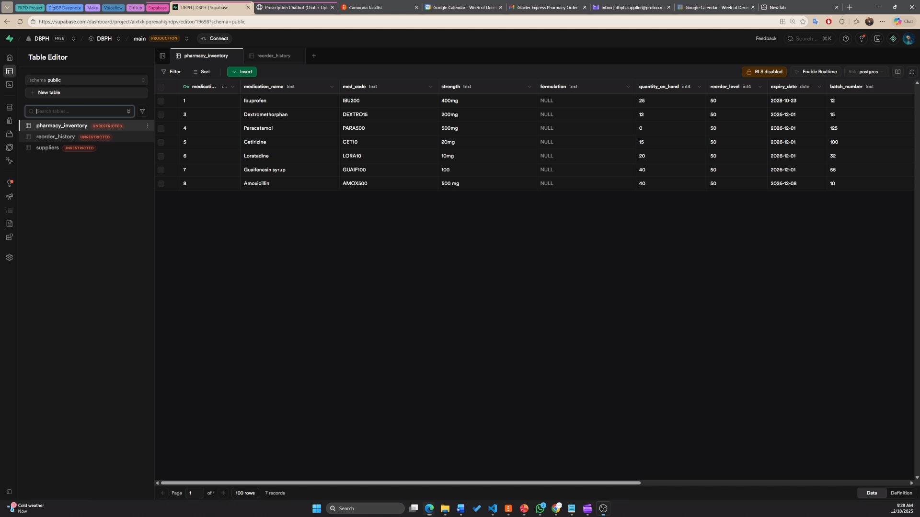
Prescription Upload

Slide 14
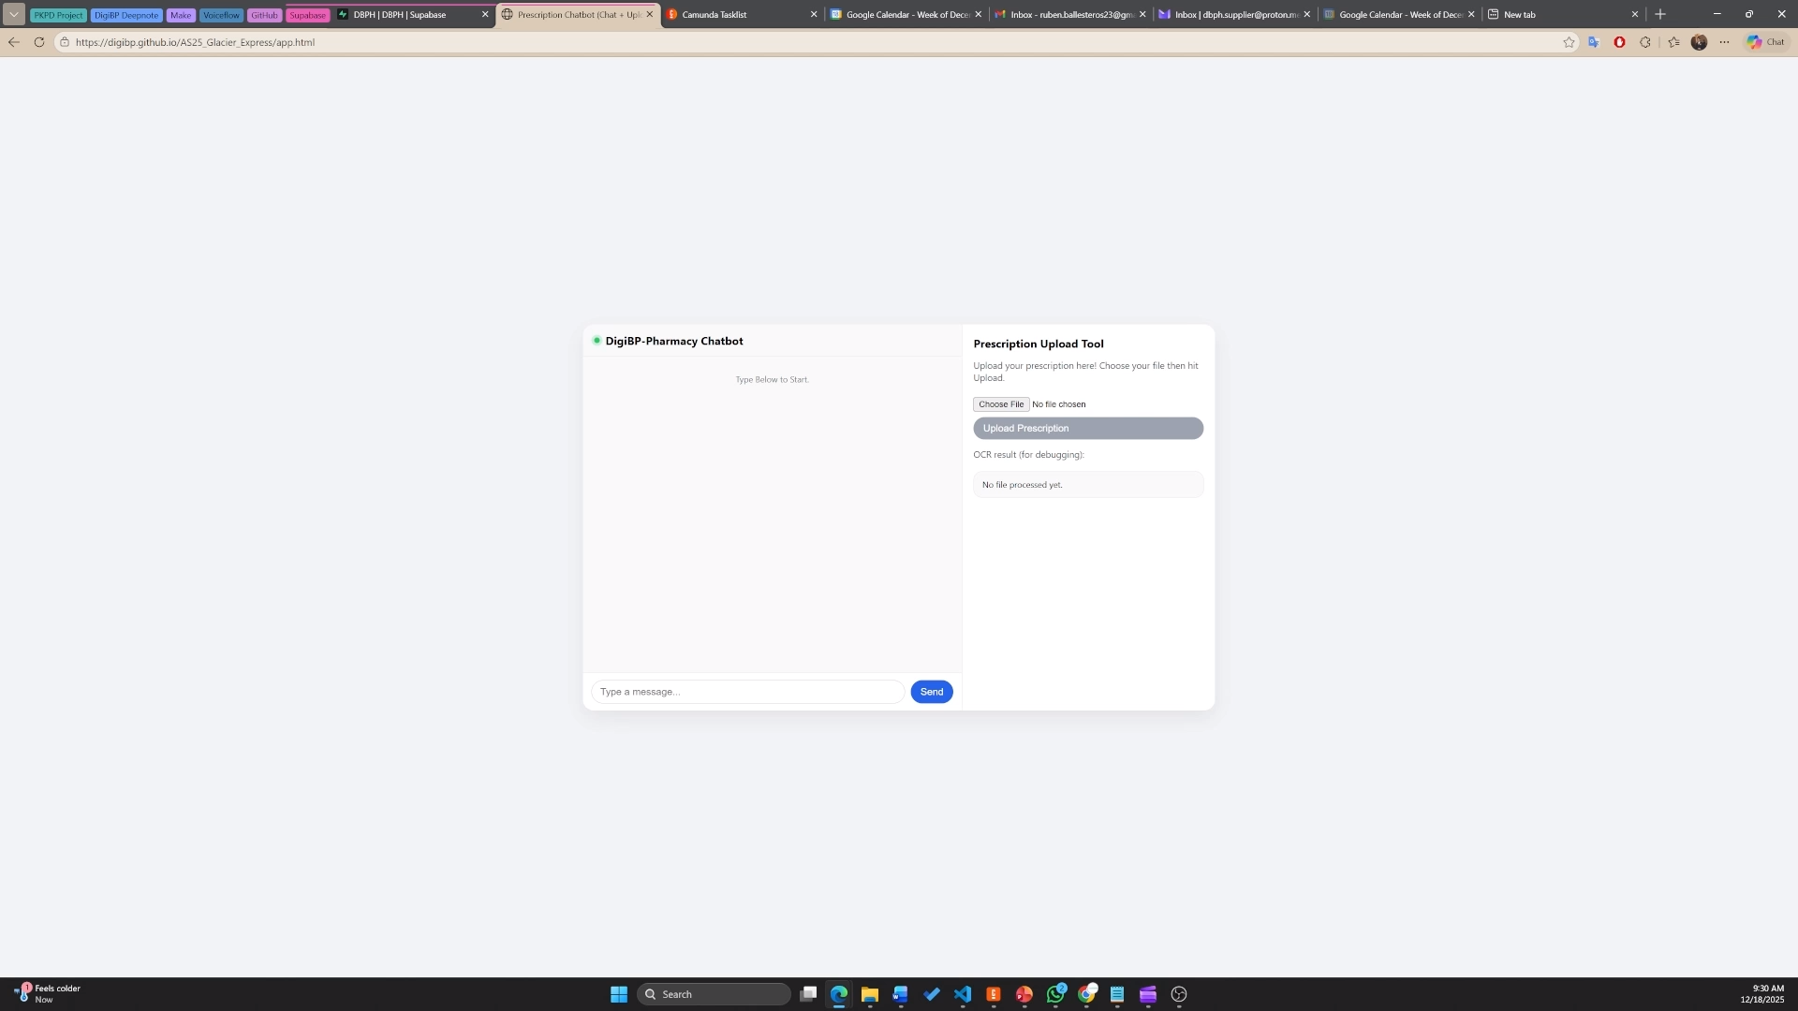
Symptom Evaluation/OTC Order

Slide 15
Thank You

